Slide 1
Android Application On Location Tracking
Prepared By: Patel Meet A (16IT081)
Rushal Patel (16IT089)

Slide 2
Table Of Contents
Project Profile And Its Goal
Details Of Tools Used
Project Management
System Requirement
Flow And Screenshots
Conclusion

Slide 3
Project Profile And Its Goal
This is a simple android app where you can brodcast your location and everyone who has your dynamically generated unique key can track you in near real-time.

Slide 4
Details Of Tools Used
ANDRIOD STUDIO
It is the official integrated development environment for Google’s Android operating system.

Slide 5
Also,
We have used Firebase DB for data storing and retrieving
Google maps API and Google Location API

Slide 6
Project Management
Learning Process and References..
The Construction of this project is laid on three pillars,
1) Learning, understanding and implementing in JAVA in android studio.
2)Linking Google firebase DB and android application. 3) How to use Google Location API

Slide 7
System Requirements
The definition of the project is ‘Building an ANDROID APPLIACATION for Location Tracking’, so this application is capable of running in any android devices having regular android configuration.

Slide 8
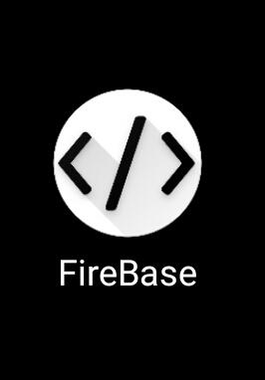
Flow and Screenshot
The logo or appearance of android app for user authentication will look like...

Slide 9
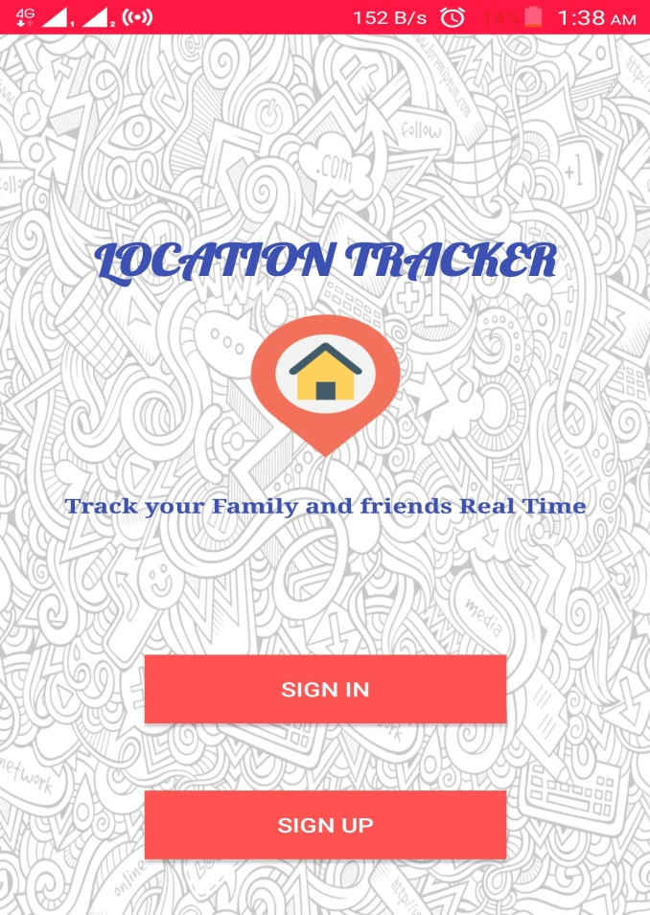
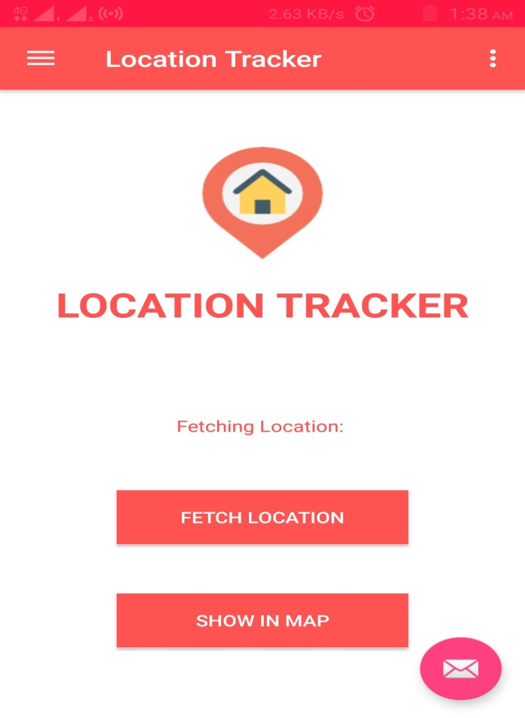

Slide 10

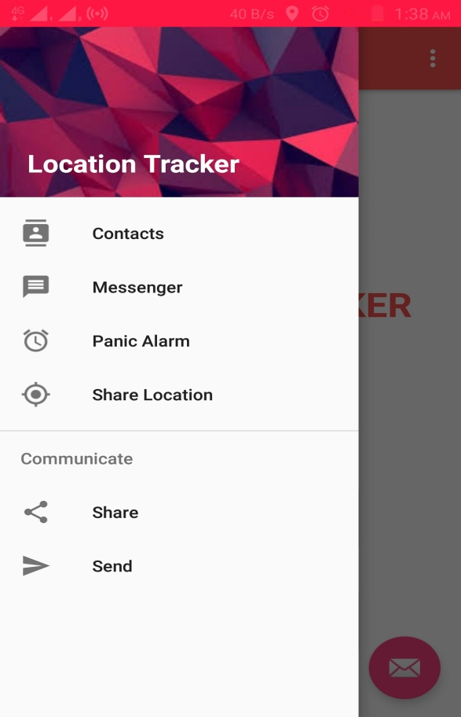

Slide 11
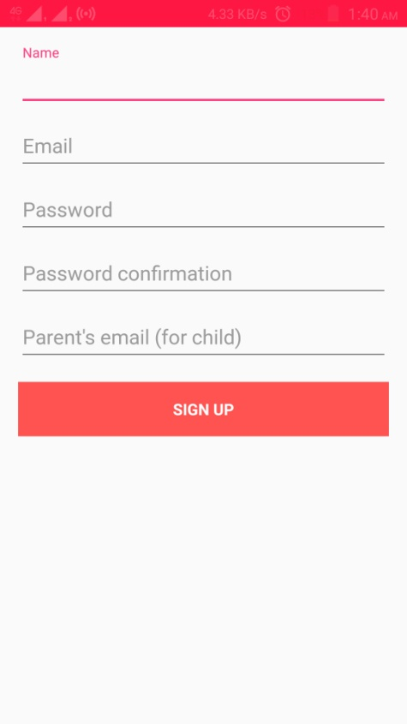
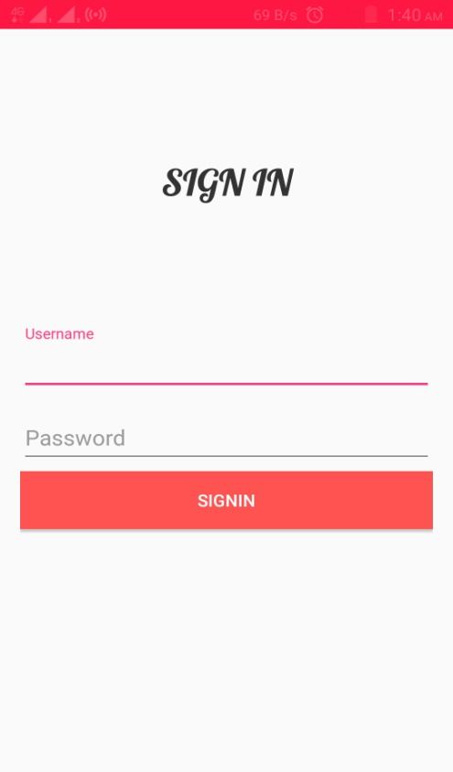

Slide 12
THANK YOU

